Slide 1

Creation of Heatmap using R for the Visualization of Microbial Diversity
Presenter: Emmanuel Ugwuoji

Slide 2
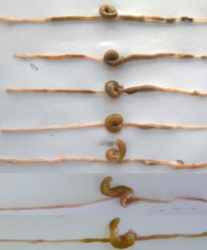
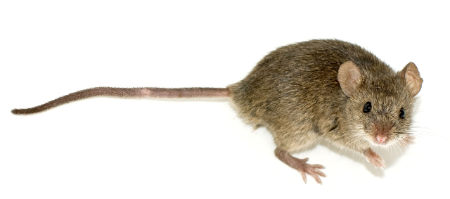
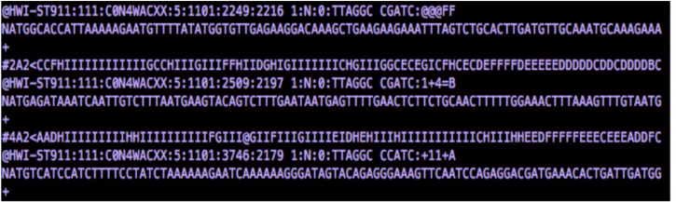

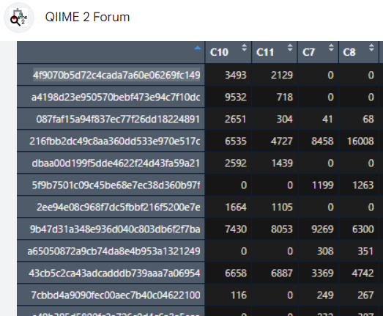
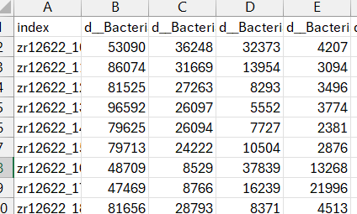
PROJECT OVERVIEW/WORKFLOW
Antibiotic exposure
16S rRNA Metagenomics
Mice
Fastq file containing 16S gene amplicon datasets
Gut content
Read in data
.csv table with read numbers
.asv table with read numbers
Notes:
I am part of a lab that does Microbiome science. Specifically, we study the gut microbiome. We understand that compositional changes in the gut microbiome influence microbiome function. These functional changes has been linked to disease conditions such as IBD, cancer, etc., A number of agents such as diet, chemicals, antibiotics can create an imbalance in the gut microbiome. This project focused on the effect of antibiotics on the gut microbiome.

Slide 3
RESEARCH QUESTIONS
Are there variations in the relative composition of the microbial populations within and across sample?
What is the relative abundance of these microbial groups?
How dissimilar are the samples microbial groups?

Slide 4
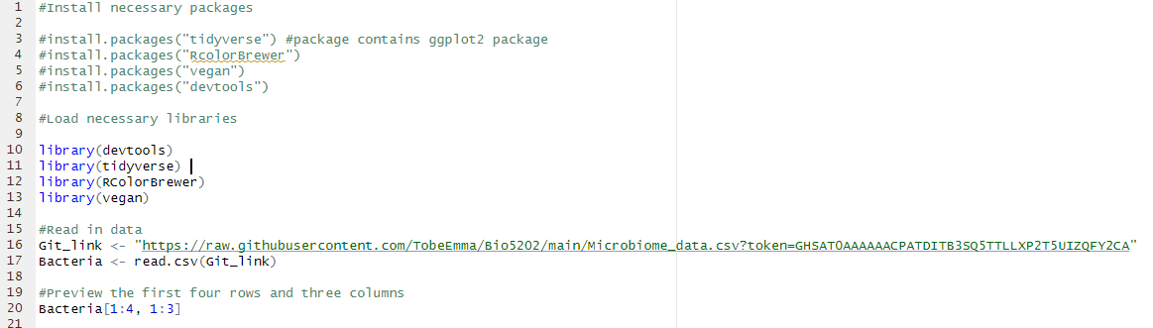
INSTALL PACKAGES, LOAD LIBRARIES AND READ IN DATA

Slide 5
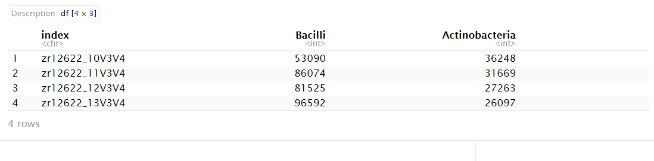
PREVIEW OF THE FIRST FOUR ROWS AND THREE COLUMNS

Slide 6
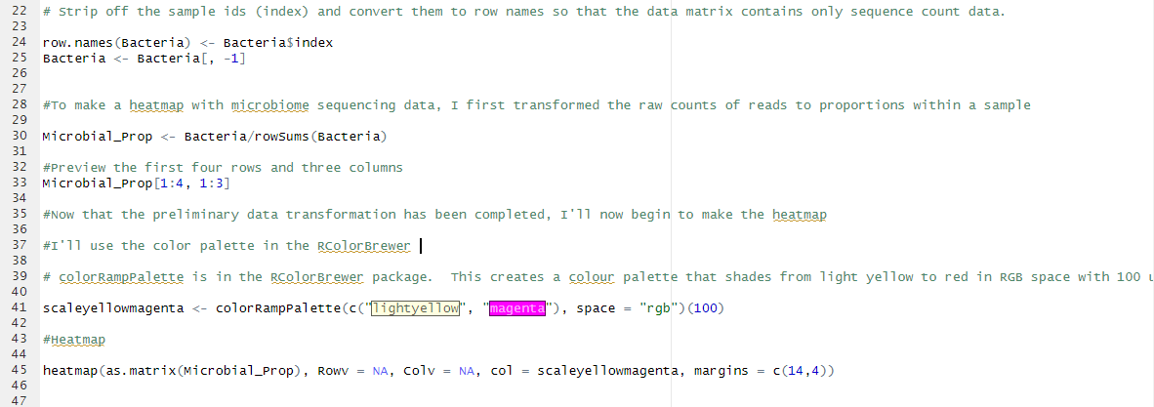
DATA TRANSFORMATION, COLOR PALETTE AND HEATMAP

Slide 7
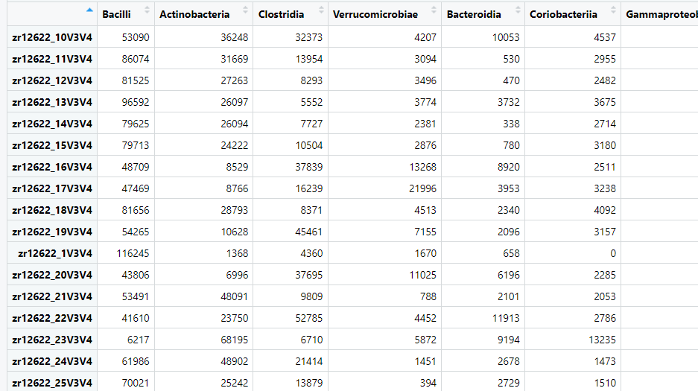
MICROBIOME DATASET

Slide 8
DATA TRANSFORMATION, COLOR PALETTE AND HEATMAP

Slide 9
DATA TRANSFORMATION, COLOR PALETTE AND HEATMAP

Slide 10
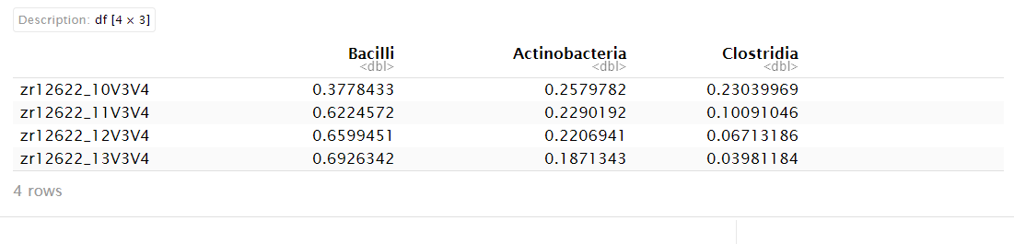
BACTERIAL PROPORTION IN SAMPLE

Slide 11
DATA TRANSFORMATION, COLOR PALETTE AND HEATMAP

Slide 12
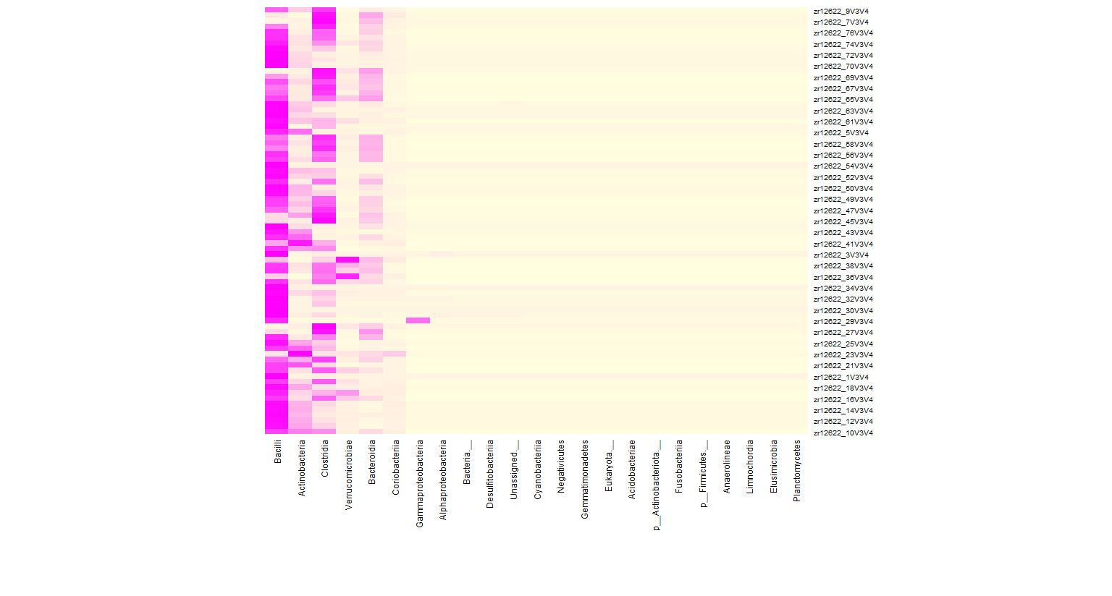
FIRST OUPUT
Bacilli is the most abundant

Slide 13
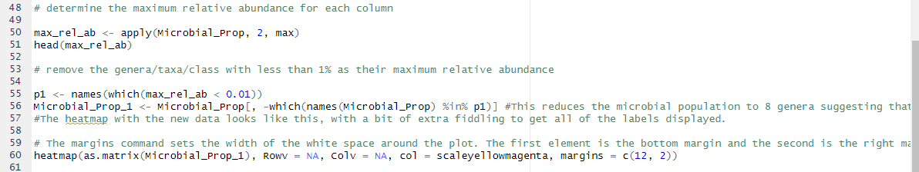

DETERMINATION OF MAXIMUM RELATIVE ABUNDANCE

Slide 14
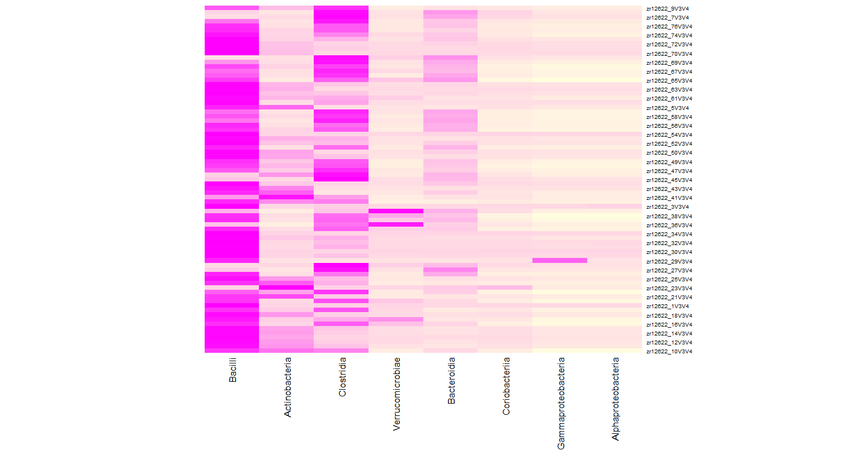
SECOND OUTPUT

Slide 15
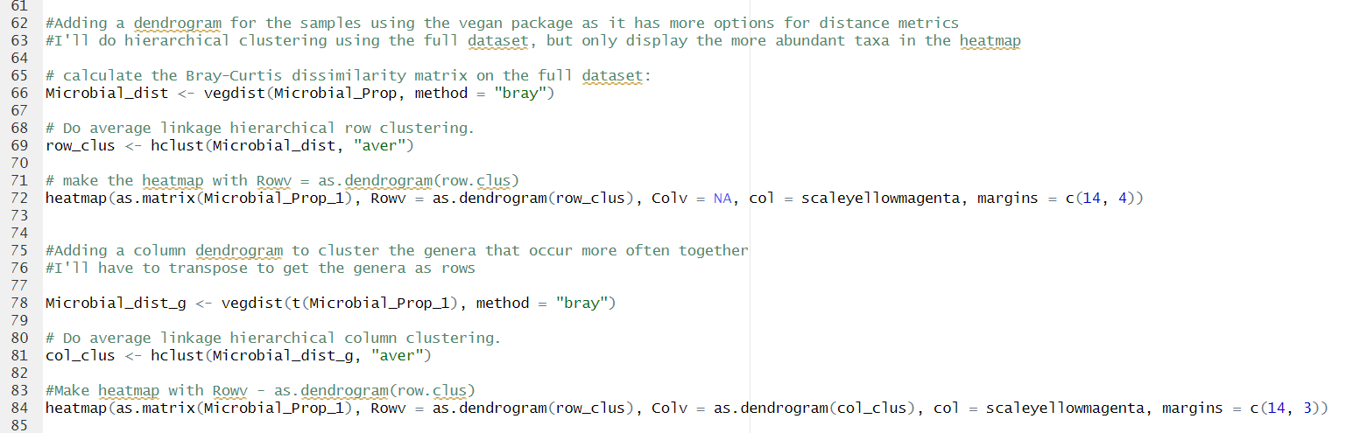
HIERARCHICAL CLUSTERING

Slide 16
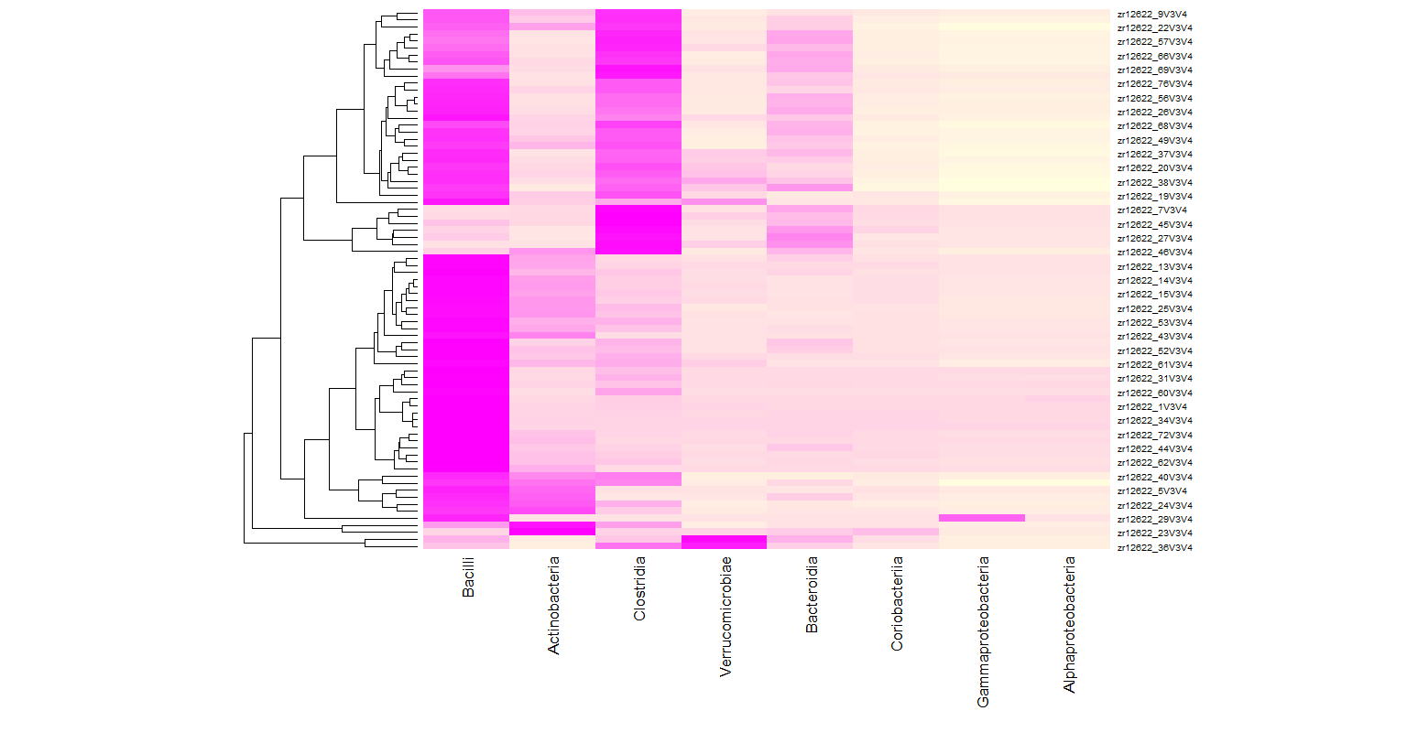
THIRD OUTPUT

Slide 17
HIERARCHICAL CLUSTERING

Slide 18
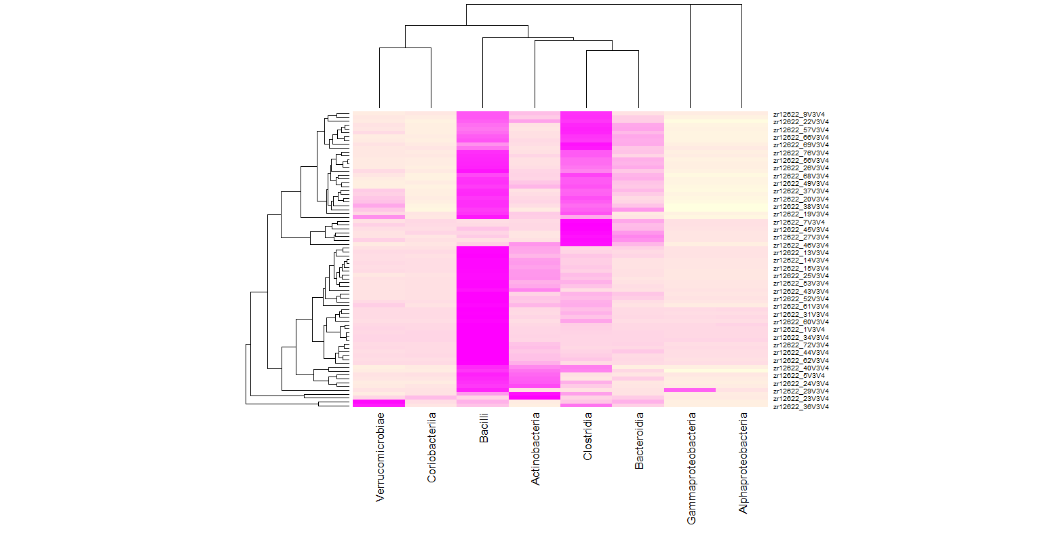
FINAL OUTPUT

Slide 19
CONCLUSIONS
Through the analysis, I was able to understand the relative composition of the microbial populations within and across samples, and
The relative abundance of these microbial groups.

Slide 20
REFERENCES
Peeters, J., Thas, O., Shkedy, Z., Kodalci, L., Musisi, C., Owokotomo, O. E., Dyczko, A., Hamad, I., Vangronsveld, J., Kleinewietfeld, M., Thijs, S., & Aerts, J. (2021, December 2). Exploring the Microbiome Analysis and Visualization Landscape. Frontiers in Bioinformatics, 1. https://doi.org/10.3389/fbinf.2021.774631
Dudek-Wicher, R. K., Junka, A., & Bartoszewicz, M. (2018). The influence of antibiotics and dietary components on gut microbiota. Przeglad gastroenterologiczny, 13(2), 85–92. https://doi.org/10.5114/pg.2018.76005.
Szilagyi A. (2020). Relationship(s) between obesity and inflammatory bowel diseases: possible intertwined pathogenic mechanisms. Clinical journal of gastroenterology, 13(2), 139–152. https://doi.org/10.1007/s12328-019-01037-y
Perrone, M. R., Romano, S., De Maria, G., Tundo, P., Bruno, A. R., Tagliaferro, L., Maffia, M., & Fragola, M. (2022). Compositional Data Analysis of 16S rRNA Gene Sequencing Results from Hospital Airborne Microbiome Samples. International journal of environmental research and public health, 19(16), 10107. https://doi.org/10.3390/ijerph191610107
García-Mazcorro, J. F., Mills, D. A., Murphy, K., & Noratto, G. (2017, August 16). Effect of barley supplementation on the fecal microbiota, caecal biochemistry, and key biomarkers of obesity and inflammation in obese db/db mice. European Journal of Nutrition. https://doi.org/10.1007/s00394-017-1523-y
Xu, Y., Xie, Z., Wang, H., Shen, Z., Guo, Y., Gao, Y., Chen, X., Qiang, W., Li, X., & Wang, K. (2017, June 15). Bacterial Diversity of Intestinal Microbiota in Patients with Substance Use Disorders Revealed by 16S rRNA Gene Deep Sequencing. Scientific Reports. https://doi.org/10.1038/s41598-017-03706-9
Williams, J. R., Yang, R., Clifford, J. L., Watson, D., Campbell, R., Getnet, D., Kumar, R., Hammamieh, R., & Jett, M. (2019). Functional Heatmap: an automated and interactive pattern recognition tool to integrate time with multi-omics assays. BMC bioinformatics, 20(1), 81. https://doi.org/10.1186/s12859-019-2657-0
Oksanen, J., Simpson, G.L..., Evangelista, H.B.A. (2022). GitHub - vegandevs/vegan: R package for community ecologists: popular ordination methods, ecological null models & diversity analysis. GitHub. https://github.com/vegandevs/vegan
Alboukadel(2019). The A - Z Of Rcolorbrewer Palette. Datanovia. https://www.datanovia.com/en/blog/the-a-z-of-rcolorbrewer-palette/
R Core Team. 2024. R: A Language and Environment for Statistical Computing. From https://www.r-project.org/

Slide 21
THANK YOU QUESTIONS?

